Slide 1







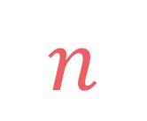

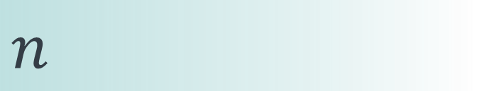

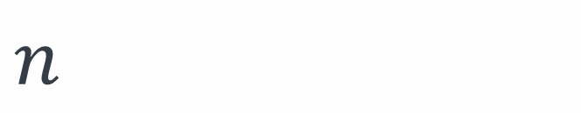
left
[4, 5, 1, 7, 2, 6, 3, 8]
no margin
Space complexity:
$$O(n)$$
list
list
list
list
mid
no margin
"string"
4 | 5 | 1 | 7 | 2 | 6 | 3 | 8
Space complexity:
$$O(n)$$
5
5
$
5
rec(n)
$$n$$
5
$$n$$
$$⇒$$
$$n$$
Time complexity:
$$O(n)$$
text
text
 |  |  | a
$$n$$
text
text
no margin
no margin
no margin
no margin
no margin
no margin
no margin
no margin

Slide 2

Rod cutting

Slide 4


Slide 5



Given a rod of length n and an array prices where prices[i] is the price of a piece of length i, return the greatest possible price that we can get by cutting the rod
$$n>0 \\ \left|prices\right|=n+1 \\ prices\left[0\right]=0 \\ prices\left[i\right]≥0$$
$$\text{maximize} \sum_{i=0}^{n}{prices\left[i\right]∗x_{i}}$$
$$\text{subject} \text{to} \sum_{i=0}^{n}{i∗x_{i}}=n \text{and} x_{i}∈ℕ_{0}$$

Slide 6

input:
n = 8
prices = [0,1,3,5,6,7,9,10,11]
output: 13
explanation: we cut the rod into a piece of length and 2 pieces of length 3, and prices[2]+prices[3]+prices[3] = 3+5+5 = 13
$$8$$

Slide 7
input:
n = 8
prices = [0,1,3,5,6,7,9,10,11]
output: 13
explanation: we cut the rod into a piece of length and 2 pieces of length 3, and prices[2]+prices[3]+prices[3] = 3+5+5 = 13
2
3
3
$$8$$

Slide 8
subsets(k, i)
subsets
(k-arr[i], i+1)
subsets(k, i+1)

Slide 9
rod(n, i)
rod(n-i, i+1)
rod(n, i+1)

Slide 10

By using this method
$x_{i}$will always be in $\{0, 1\}$ while the problem mentions that it can be in $\{0,1,2,3,…\}$

Slide 11

rod(
)
$$5$$

Slide 12
rod(
)
prices[
] + rod(
)

Slide 13
rod(
)
prices[
] + rod(
)
prices[
] + rod(
)

Slide 14
rod(
)
prices[
] + rod(
)
prices[
] + rod(
)
prices[
] + rod(
)

Slide 15
rod(
)
prices[
] + rod(
)
prices[
] + rod(
)
prices[
] + rod(
)
prices[
] + rod(
)

Slide 16
rod(
)
prices[
] + rod(
)
prices[
] + rod(
)
prices[
] + rod(
)
prices[
] + rod(
)
prices[
] + rod(
)

Slide 17

$$rod\left(5\right)=max⁡(prices\left[1\right]+rod\left(4\right), \\ prices\left[2\right]+rod\left(3\right), \\ prices\left[3\right]+rod\left(2\right), \\ prices\left[4\right]+rod\left(1\right), \\ prices\left[5\right]+rod(0))$$

Slide 18
$$rod\left(n\right)=\max_{length∈[1,n]}{prices\left[length\right]+rod(n−length)}$$

Slide 19
rod(5)
rod(4)
rod(3)
rod(2)
rod(1)
rod(0)
rod(3)
rod(2)
rod(1)
rod(0)
rod(2)
rod(1)
rod(0)
rod(1)
rod(0)
rod(0)
rod(2)
rod(1)
rod(0)
rod(1)
rod(0)
rod(0)
rod(1)
rod(0)
rod(0)
rod(0)
rod(1)
rod(0)
rod(0)
rod(0)
rod(0)
rod(0)

Slide 20

$$n=0→0$$

Slide 21




$$0$$
$$if n=0$$
$$rod\left(n\right)=$$
$$\max_{length∈[1,n]}{prices\left[length\right]+rod(n−length)}$$
$$otherwise$$

Slide 22




def rod(prices, n): max_price = 0 for length in range(1, n+1): max_price = max(max_price,
prices[length]+rod(prices, n-length)) return max_price
$$0$$
$$if n=0$$
$$rod\left(n\right)=$$
$$\max_{length∈[1,n]}{prices\left[length\right]+rod(n−length)}$$
$$otherwise$$

Slide 23
def rod(prices, n): max_price = 0 for length in range(1, n+1): max_price = max(max_price,
prices[length]+rod(prices, n-length)) return max_price
$$T\left(n\right)=T\left(n−1\right)+T\left(n−2\right)+…+T\left(0\right)+n$$

Slide 24

def rod(prices, n): max_price = 0 for length in range(1, n+1): max_price = max(max_price,
prices[length]+rod(prices, n-length)) return max_price
$$T(0)=1$$
$$T\left(n\right)=T\left(n−1\right)+T\left(n−2\right)+…+T\left(0\right)+n$$

Slide 25
def rod(prices, n): max_price = 0 for length in range(1, n+1): max_price = max(max_price,
prices[length]+rod(prices, n-length)) return max_price
$$T(0)=1$$
$$T\left(n\right)=T\left(n−1\right)+T\left(n−2\right)+…+T\left(0\right)+n$$
$$T\left(n−1\right)=T\left(n−2\right)+T\left(n−3\right)+…+T\left(0\right)+n−1$$

Slide 26

def rod(prices, n): max_price = 0 for length in range(1, n+1): max_price = max(max_price,
prices[length]+rod(prices, n-length)) return max_price
$$T(0)=1$$
$$T\left(n\right)=T\left(n−1\right)+T\left(n−2\right)+…+T\left(0\right)+n−1+1$$
$$T(n−1)$$
$$T\left(n−1\right)=T\left(n−2\right)+T\left(n−3\right)+…+T\left(0\right)+n−1$$

Slide 27

def rod(prices, n): max_price = 0 for length in range(1, n+1): max_price = max(max_price,
prices[length]+rod(prices, n-length)) return max_price
$$T(0)=1$$
$$T\left(n\right)=T\left(n−1\right)+T\left(n−2\right)+…+T\left(0\right)+n−1+1$$
$$T\left(n\right)=T\left(n−1\right)+T(n−1)+O(1)$$
$$T\left(n\right)=2T\left(n−1\right)+O(1)$$

Slide 28



$$T(0)=1$$
$$T\left(n\right)=T\left(n−1\right)+T\left(n−2\right)+…+T\left(0\right)+n−1+1$$
$$T\left(n\right)=T\left(n−1\right)+T(n−1)+O(1)$$
$$T\left(n\right)=2T\left(n−1\right)+O(1)$$
$$T\left(n\right)=2\left(2T\left(n−2\right)+O\left(1\right)\right)+O\left(1\right) \\ T\left(n\right)=4T\left(n−2\right)+3∗O\left(1\right) \\ T\left(n\right)=4\left(2T\left(n−3\right)+O\left(1\right)\right)+3∗O\left(1\right) \\ T\left(n\right)=8T\left(n−3\right)+7∗O\left(1\right) \\ . \\ T\left(n\right)=2^{k}T\left(n−k\right)+\left(2^{k}−1\right)∗O\left(1\right) \\ . \\ T\left(n\right)=2^{n}T\left(n−n\right)+\left(2^{n}−1\right)∗O\left(1\right) \\ T\left(n\right)=2^{n}T\left(0\right)+\left(2^{n}−1\right)∗O\left(1\right) \\ T\left(n\right)=2^{n}+\left(2^{n}−1\right)∗O\left(1\right) \\ T\left(n\right)=O(2^{n})$$

Slide 29

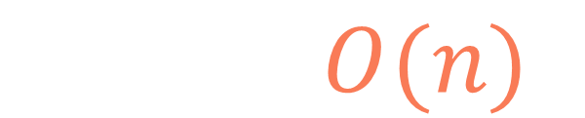
rod(5)
$$n+1$$
rod(4)
rod(3)
rod(2)
rod(1)
rod(0)
rod(3)
rod(2)
rod(1)
rod(0)
rod(2)
rod(1)
rod(0)
rod(1)
rod(0)
rod(0)
rod(2)
rod(1)
rod(0)
rod(1)
rod(0)
rod(0)
rod(1)
rod(0)
rod(0)
rod(0)
rod(1)
rod(0)
rod(0)
rod(0)
rod(0)
$$S\left(n\right)=O(n)$$
rod(0)

Slide 30
input:
n = 8
prices = [0,1,3,5,6,7,9,10,11]
rod(8)
rod(7)
rod(6)
rod(5)
rod(4)
rod(3)
rod(2)
rod(1)
rod(0)

Slide 31
input:
n = 8
prices = [0,1,3,5,6,7,9,10,11]
rod(8)
rod(7)
rod(6)
rod(5)
rod(4)
rod(3)
rod(2)
rod(1)
rod(0)

Slide 32
1
def rod(prices, n, lookup=None): lookup = {} if lookup is None else lookup if n in lookup: return lookup[n] max_price = 0 for length in range(1, n+1): max_price = max(max_price,
prices[length]+rod(prices, n-length, lookup)) lookup[n] = max_price return lookup[n]
2
3
4
4

Slide 33


$$n∈\{n_{0},n_{0}−1,…,1,0\}$$
$$n+1$$

Slide 34

$$n∈\{n_{0},n_{0}−1,…,1,0\}$$
$$n+1$$
def rod(prices, n, lookup=None): lookup = {} if lookup is None else lookup if n in lookup: return lookup[n] max_price = 0 for length in range(1, n+1): max_price = max(max_price,
prices[length]+rod(prices, n-length, lookup)) lookup[n] = max_price return lookup[n]
$$n$$

Slide 35
$$n∈\{n_{0},n_{0}−1,…,1,0\}$$
$$n+1$$
def rod(prices, n, lookup=None): lookup = {} if lookup is None else lookup if n in lookup: return lookup[n] max_price = 0 for length in range(1, n+1): max_price = max(max_price,
prices[length]+rod(prices, n-length, lookup)) lookup[n] = max_price return lookup[n]
$$n$$
$$T\left(n\right)=n∗O\left(n\right)+1∗O\left(1\right)=O(n^{2})$$

Slide 36
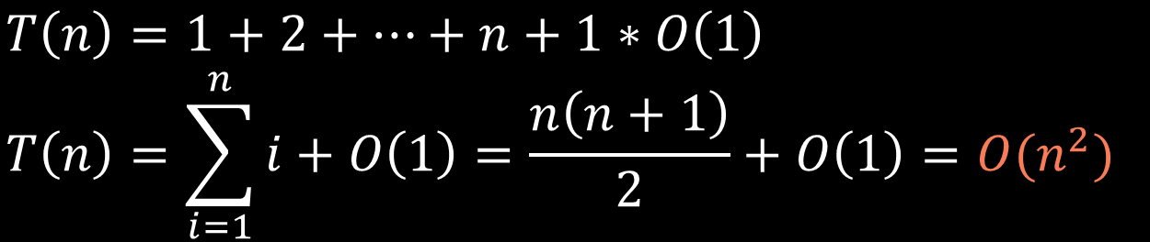
$$n∈\{n_{0},n_{0}−1,…,1,0\}$$
$$n+1$$
def rod(prices, n, lookup=None): lookup = {} if lookup is None else lookup if n in lookup: return lookup[n] max_price = 0 for length in range(1, n+1): max_price = max(max_price,
prices[length]+rod(prices, n-length, lookup)) lookup[n] = max_price return lookup[n]
$$T\left(n\right)=1+2+…+n+1∗O\left(1\right) \\ T\left(n\right)=\sum_{i=1}^{n}{i}+O\left(1\right)=\frac{n\left(n+1\right)}{2}+O\left(1\right)=O(n^{2})$$

Slide 37
$$S\left(n\right)=O\left(n\right)+O(n)=O(n)$$
call stack size
lookup table size

Slide 38



$$n∈\{n_{0},n_{0}−1,…,1,0\}$$
$$n+1$$
dp
$$n+1$$

Slide 39
dp
dp[n] represents the maximum price that we can get by cutting a rod of length n

Slide 40
dp
dp[i] represents the maximum price that we can get by cutting a rod of length i

Slide 41
dp
0

Slide 42

dp
0
$$dp\left[5\right]=max⁡(prices\left[1\right]+dp\left[5−1\right], \\ prices\left[2\right]+dp\left[5−2\right], \\ prices\left[3\right]+dp\left[5−3\right], \\ prices\left[4\right]+dp\left[5−4\right], \\ prices\left[5\right]+dp[5−5])$$

Slide 43
dp
0
def rod(prices, n): dp = [0]*(n+1) for i in range(1, n+1): for length in range(1, i+1): dp[i] = max(dp[i],
prices[length]+dp[i-length]) return dp[n]

Slide 44
dp
0
input:
n = 8
prices = [0,1,3,5,6,7,9,10,11]
def rod(prices, n): dp = [0]*(n+1) for i in range(1, n+1): for length in range(1, i+1): dp[i] = max(dp[i],
prices[length]+dp[i-length]) return dp[n]

Slide 45
dp
0
dp[1] = max⁡(1+0) = 1
input:
n = 8
prices = [0,1,3,5,6,7,9,10,11]
def rod(prices, n): dp = [0]*(n+1) for i in range(1, n+1): for length in range(1, i+1): dp[i] = max(dp[i],
prices[length]+dp[i-length]) return dp[n]

Slide 46
dp
0
1
dp[1] = max⁡(1+0) = 1
input:
n = 8
prices = [0,1,3,5,6,7,9,10,11]
def rod(prices, n): dp = [0]*(n+1) for i in range(1, n+1): for length in range(1, i+1): dp[i] = max(dp[i],
prices[length]+dp[i-length]) return dp[n]

Slide 47
dp
0
1
dp[2] = max⁡(1+1, 3+0) = 3
input:
n = 8
prices = [0,1,3,5,6,7,9,10,11]
def rod(prices, n): dp = [0]*(n+1) for i in range(1, n+1): for length in range(1, i+1): dp[i] = max(dp[i],
prices[length]+dp[i-length]) return dp[n]

Slide 48
dp
0
1
3
dp[2] = max⁡(1+1, 3+0) = 3
input:
n = 8
prices = [0,1,3,5,6,7,9,10,11]
def rod(prices, n): dp = [0]*(n+1) for i in range(1, n+1): for length in range(1, i+1): dp[i] = max(dp[i],
prices[length]+dp[i-length]) return dp[n]

Slide 49
dp
0
1
3
dp[3] = max⁡(1+3, 3+1, 5+0) = 5
input:
n = 8
prices = [0,1,3,5,6,7,9,10,11]
def rod(prices, n): dp = [0]*(n+1) for i in range(1, n+1): for length in range(1, i+1): dp[i] = max(dp[i],
prices[length]+dp[i-length]) return dp[n]

Slide 50
dp
0
1
3
5
dp[3] = max⁡(1+3, 3+1, 5+0) = 5
input:
n = 8
prices = [0,1,3,5,6,7,9,10,11]
def rod(prices, n): dp = [0]*(n+1) for i in range(1, n+1): for length in range(1, i+1): dp[i] = max(dp[i],
prices[length]+dp[i-length]) return dp[n]

Slide 51
dp
0
1
3
5
dp[4] = max⁡(1+5, 3+3, 5+1, 6+0) = 6
input:
n = 8
prices = [0,1,3,5,6,7,9,10,11]
def rod(prices, n): dp = [0]*(n+1) for i in range(1, n+1): for length in range(1, i+1): dp[i] = max(dp[i],
prices[length]+dp[i-length]) return dp[n]

Slide 52
dp
0
1
3
5
6
dp[4] = max⁡(1+5, 3+3, 5+1, 6+0) = 6
input:
n = 8
prices = [0,1,3,5,6,7,9,10,11]
def rod(prices, n): dp = [0]*(n+1) for i in range(1, n+1): for length in range(1, i+1): dp[i] = max(dp[i],
prices[length]+dp[i-length]) return dp[n]

Slide 53
dp
0
1
3
5
6
dp[5] = max⁡(1+6, 3+5, 5+3, 6+1, 7+0) = 8
input:
n = 8
prices = [0,1,3,5,6,7,9,10,11]
def rod(prices, n): dp = [0]*(n+1) for i in range(1, n+1): for length in range(1, i+1): dp[i] = max(dp[i],
prices[length]+dp[i-length]) return dp[n]

Slide 54
dp
0
1
3
5
6
8
dp[5] = max⁡(1+6, 3+5, 5+3, 6+1, 7+0) = 8
input:
n = 8
prices = [0,1,3,5,6,7,9,10,11]
def rod(prices, n): dp = [0]*(n+1) for i in range(1, n+1): for length in range(1, i+1): dp[i] = max(dp[i],
prices[length]+dp[i-length]) return dp[n]

Slide 55
dp
0
1
3
5
6
8
dp[6] = max⁡(1+8, 3+6, 5+5, 6+3, 7+1, 9+0) = 10
input:
n = 8
prices = [0,1,3,5,6,7,9,10,11]
def rod(prices, n): dp = [0]*(n+1) for i in range(1, n+1): for length in range(1, i+1): dp[i] = max(dp[i],
prices[length]+dp[i-length]) return dp[n]

Slide 56
dp
0
1
3
5
6
8
10
dp[6] = max⁡(1+8, 3+6, 5+5, 6+3, 7+1, 9+0) = 10
input:
n = 8
prices = [0,1,3,5,6,7,9,10,11]
def rod(prices, n): dp = [0]*(n+1) for i in range(1, n+1): for length in range(1, i+1): dp[i] = max(dp[i],
prices[length]+dp[i-length]) return dp[n]

Slide 57
dp
0
1
3
5
6
8
10
dp[7] = max⁡(1+10, 3+8, 5+6, 6+5, 7+3, 9+1, 10+0) = 11
input:
n = 8
prices = [0,1,3,5,6,7,9,10,11]
def rod(prices, n): dp = [0]*(n+1) for i in range(1, n+1): for length in range(1, i+1): dp[i] = max(dp[i],
prices[length]+dp[i-length]) return dp[n]

Slide 58
dp
0
1
3
5
6
8
10
11
dp[7] = max⁡(1+10, 3+8, 5+6, 6+5, 7+3, 9+1, 10+0) = 11
input:
n = 8
prices = [0,1,3,5,6,7,9,10,11]
def rod(prices, n): dp = [0]*(n+1) for i in range(1, n+1): for length in range(1, i+1): dp[i] = max(dp[i],
prices[length]+dp[i-length]) return dp[n]

Slide 59
dp
0
1
3
5
6
8
10
11
dp[8] = max⁡(1+11, 3+10, 5+8, 6+6, 7+5, 9+3, 10+1, 11+0) = 13
input:
n = 8
prices = [0,1,3,5,6,7,9,10,11]
def rod(prices, n): dp = [0]*(n+1) for i in range(1, n+1): for length in range(1, i+1): dp[i] = max(dp[i],
prices[length]+dp[i-length]) return dp[n]

Slide 60
dp
0
1
3
5
6
8
10
11
13
dp[8] = max⁡(1+11, 3+10, 5+8, 6+6, 7+5, 9+3, 10+1, 11+0) = 13
input:
n = 8
prices = [0,1,3,5,6,7,9,10,11]
def rod(prices, n): dp = [0]*(n+1) for i in range(1, n+1): for length in range(1, i+1): dp[i] = max(dp[i],
prices[length]+dp[i-length]) return dp[n]

Slide 61
dp
0
1
3
5
6
8
10
11
13
input:
n = 8
prices = [0,1,3,5,6,7,9,10,11]
def rod(prices, n): dp = [0]*(n+1) for i in range(1, n+1): for length in range(1, i+1): dp[i] = max(dp[i],
prices[length]+dp[i-length]) return dp[n]

Slide 62
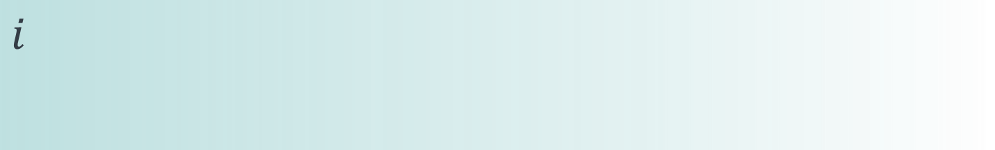
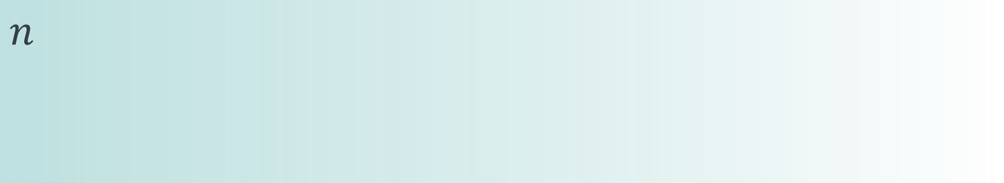
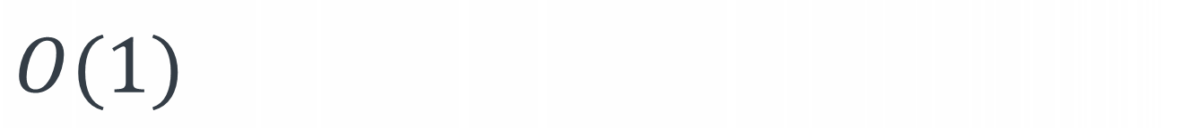
def rod(prices, n): dp = [0]*(n+1) for i in range(1, n+1): for length in range(1, i+1): dp[i] = max(dp[i],
prices[length]+dp[i-length]) return dp[n]
$$n$$
$$i$$
$$O(1)$$

Slide 63
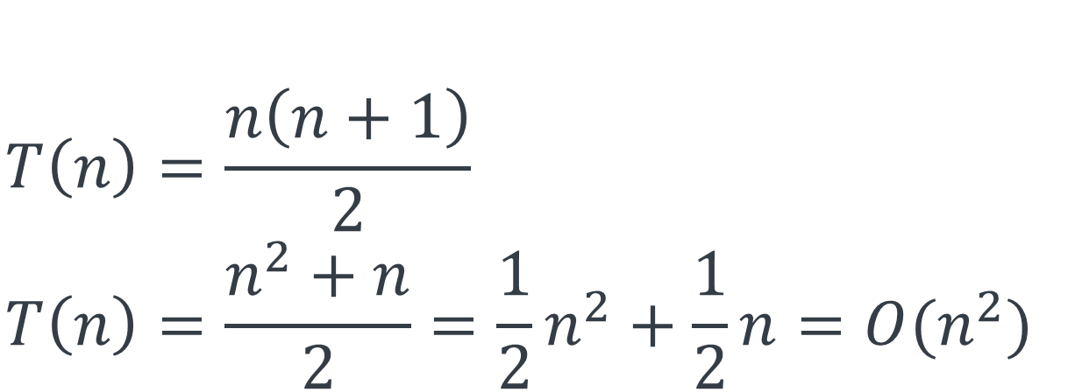
def rod(prices, n): dp = [0]*(n+1) for i in range(1, n+1): for length in range(1, i+1): dp[i] = max(dp[i],
prices[length]+dp[i-length]) return dp[n]
$$n$$
$$i$$
$$O(1)$$
$$T\left(n\right)=1+2+3+…+n \\ T\left(n\right)=\frac{n\left(n+1\right)}{2} \\ T\left(n\right)=\frac{n^{2}+n}{2}=\frac{1}{2}n^{2}+\frac{1}{2}n=O(n^{2})$$

Slide 64

def rod(prices, n): dp = [0]*(n+1) for i in range(1, n+1): for length in range(1, i+1): dp[i] = max(dp[i],
prices[length]+dp[i-length]) return dp[n]
$$n$$
$$i$$
$$O(1)$$
$$T\left(n\right)=1+2+3+…+n \\ T\left(n\right)=\frac{n\left(n+1\right)}{2} \\ T\left(n\right)=\frac{n^{2}+n}{2}=\frac{1}{2}n^{2}+\frac{1}{2}n=O(n^{2})$$

Slide 65

def rod(prices, n): dp = [0]*(n+1) for i in range(1, n+1): for length in range(1, i+1): dp[i] = max(dp[i],
prices[length]+dp[i-length]) return dp[n]
$$n$$
$$i$$
$$O(1)$$
$$T\left(n\right)=1+2+3+…+n \\ T\left(n\right)=\frac{n\left(n+1\right)}{2} \\ T\left(n\right)=\frac{n^{2}+n}{2}=\frac{1}{2}n^{2}+\frac{1}{2}n=O(n^{2})$$

Slide 66
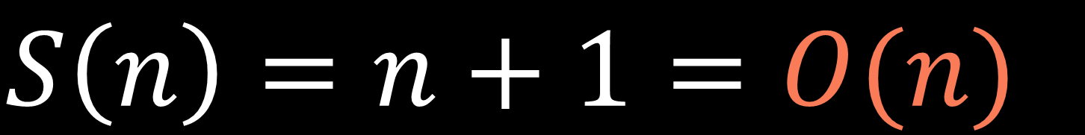

def rod(prices, n): dp = [0]*(n+1) for i in range(1, n+1): for length in range(1, i+1): dp[i] = max(dp[i],
prices[length]+dp[i-length]) return dp[n]
$$n+1$$
$$S\left(n\right)=n+1=O(n)$$

Slide 67
dp
0
1
3
5
6
8
10
11
13
dp[8] = max⁡(1+11, 3+10, 5+8, 6+6, 7+5, 9+3, 10+1, 11+0) = 13
input:
n = 8
prices = [0,1,3,5,6,7,9,10,11]
def rod(prices, n): dp = [0]*(n+1) for i in range(1, n+1): for length in range(1, i+1): dp[i] = max(dp[i],
prices[length]+dp[i-length]) return dp[n]

Slide 68

0-1 knapsack problem

Slide 69


0-1 knapsack problem
$$\text{maximize} \sum_{i=0}^{n−1}{v_{i}∗x_{i}}$$
$$\text{subject} \text{to} \sum_{i=0}^{n−1}{w_{i}∗x_{i}}≤\text{k} \text{and} x_{i}∈\{0,1\}$$

Slide 70

Unbounded knapsack problem
$$\text{maximize} \sum_{i=0}^{n−1}{v_{i}∗x_{i}}$$
$$\text{subject} \text{to} \sum_{i=0}^{n−1}{w_{i}∗x_{i}}≤\text{k} \text{and} x_{i}∈ℕ_{0}$$

Slide 71




Unbounded knapsack problem
$$\text{maximize} \sum_{i=0}^{n−1}{v_{i}∗x_{i}}$$
$$\text{subject} \text{to} \sum_{i=0}^{n−1}{w_{i}∗x_{i}}≤\text{k} \text{and} x_{i}∈ℕ_{0}$$
$$\text{maximize} \sum_{i=0}^{n}{prices\left[i\right]∗x_{i}}$$
Rod
cutting
problem
$$\text{subject} \text{to} \sum_{i=0}^{n}{i∗x_{i}}=n \text{and} x_{i}∈ℕ_{0}$$

Slide 72
Unbounded knapsack problem
$$\text{maximize} \sum_{i=0}^{n−1}{v_{i}∗x_{i}}$$
$$\text{subject} \text{to} \sum_{i=0}^{n−1}{w_{i}∗x_{i}}≤\text{k} \text{and} x_{i}∈ℕ_{0}$$
$$\text{maximize} \sum_{i=0}^{n}{prices\left[i\right]∗x_{i}}$$
Rod
cutting
problem
$$\text{subject} \text{to} \sum_{i=0}^{n}{i∗x_{i}}=n \text{and} x_{i}∈ℕ_{0}$$

Slide 73
def rod(prices, n): k = n values = prices[1:] weights = list(range(1, n+1)) #[1, 2, ..., n] return unbounded_knapsack(values, weights, k)

